Slide 1
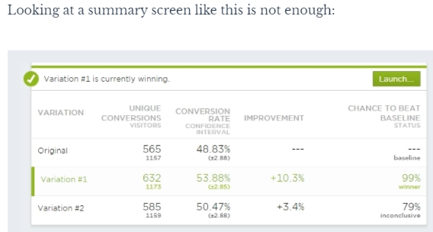
A/B Tests
A series of A/B tests can rapidly lead to an optimized design
If huge sample sizes then even small, effects can be reliably detected and have high impacts
Run test long enough to achieve statistical signficance
Avoids costs of recruiting participants since they don’t even know they are the subjects of an experiment + no need to get ethical approval to use them as guinea pigs
Often consider ATE (average treatment effect)
If want to do cohort-level analysis will need larger sample
May not find stat significance at pop level but do within cohorts
Lift =
(Treatment Conversion Rate – Control Conversion Rate )/ Control Conversion Rate
Considerations
Novelty effect – consumer behaviour changes initially before regressing to before i.e ATE is overestimated
Primary effect - reluctant to change behaviour now but might be more interested in later stages i.e. ATE underestimated
See also Causation Analysis / Difference in Difference Analysis (DiD) / RDD (Regression discontinuity design)
Use Case Types
Design related
Site page
Wording of text
Model related
Impact on KPIs e.g. churn / upgrades / ARPU
Algorithm related
New product / feature launch

Slide 2
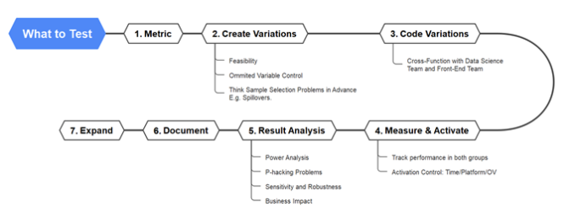
Power Analysis
If I set the power to 0.8 based on empirical literature and the statistical power calculator gives me a sample size of 9 then I can say if I get 9 measurements per group, I will have an 80% chance of correctly rejecting the null hypothesis
Experimental length?
Can depend on traffic / rate of success
Might depend on time of year
T-test analysis
Independent t-test to compare mean of two groups
Pair sample t-test to compare mean of one group before and after treatment
One sample t-test to compare mean to a specific value
Interferences between control and treatment group?
Confounding variables
Sample selection bias
Reverse causality
Omitted variable bias

Slide 3
AB Testing Design Tips
Do not run AB test if not enough traffic → will take too long to achieve statistical significance
Means that a losing treatment model has larger impact on revenue streams
Instead recommend trying a more radical model where likely to see stark difference sin your metric (conversion/lift etc.) so should see results quicker
Recommend starting with one treatment rather than multiple
Impatient SH can lead to A/B/C/D testing. The more variations you test, the higher the chance of FP
Besides, the fewer variants you do, the faster you’ll get results and can iterate
Need some sophistication in your experimental design. If comparing the effectiveness of a model
Do not call A/B tests early!! Wait until have a sufficient sample size
Do not stop exactly when sample size achieved – wait until end of week/month etc. to ensure representative period covered (so that final cycle can be compared against all other cycle measurement periods)
Run tests for full week – as can get day to day variation e.g. higher conversion on weekend vs week start → can skew results
Run test for a couple of business cycles to handle day of week impacts / various traffic sources / external factors like payday / etc.
Consider seasonality & external impacts
Your treatment might be better during Xmas or a PINC period, but not outside of these periods
Maybe a news story or competitor entry could impact each model differently too
Even a 1% lift can be a lot! Do not be disheartened.
1% over 12 one month periods can result in 12% annual lift
12% could be huge if volumes are huge
Also, your site could be performing very well at present anyway, so any incremental gain is good!
Every day without a test is wasted. Should constantly be learning what works and what doesn’t
Make sure you have a large enough sample size for any segment analysis you wish to undertake

Slide 4
Normally would try to split control:treatment 50:50
Try to split control:treatment 50:50 for fastest results (faster better as reduces longitudinal variables too) but may not be possible e.g. SH reluctant
How to compare the (mean) save rate across unequal sample sizes?
Most efficient to run a t-test with equal sample size else power of the t-test is reduced i.e. for a given N (total sample size), power is maximized if split 50:50
Power is based on the smaller of the two sample sizes, so if adding more observations to larger group, then has no effect on power
Analogy - If want to know the area of a rectangle, and the perimeter is fixed, then the area (or power) will be maximized if the length and width are equal (i.e., if the rectangle is a square OR sample size is split 50:50). On the other hand, as the length and width diverge (as the rectangle becomes elongated), the area shrinks.
Why T test can still handle unequal sample sizes? Considers standard error of the estimates of the means for each group. The group with more samples will have smaller standard error than if the population standard deviations are approx equal

Slide 5
Sample Size Estimation
If we make changes to control, the timeline to reach statistical significance will reset. When mitigation is applied it reduces the volume of customers routed through model 0, which could extend time required to be confident in the save rate of model 0
Approach 1: Min sample size needed to ensure the confidence interval of the difference in save rates has width x e.g. ensures that we have a point estimate of 65% (theoretical save rate for the population), with a confidence interval of width W at a confidence level 1-α? Two-sided t-test
Approach 2: Power Analysis Approach –
One sided Proportional T-test
Min sample size needed to test whether our alternative hypothesis, that the effect size of the treatment is statistically significant
Or if wantg cohort analysis, min sample size required for each group to detect a stat significant difference between two proportions
Need:
Power of test (~80%) i.e. proba of detecting a significant difference when one exists
Confidence Level
Effect Size (proportions in treatment and control effectively e.g. 67% save rate in control, 68% in treatment)

Slide 6
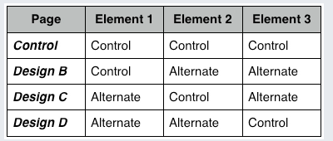
Multivariate Testing
Testing more than one component on the website in a live environment
Is about measuring interaction effects between independent elements to see which combination works best
Running multiple A/B tests on the same page at the same time
Because of the additional variations, this requires more time to achieve a large enough sample size

Slide 7
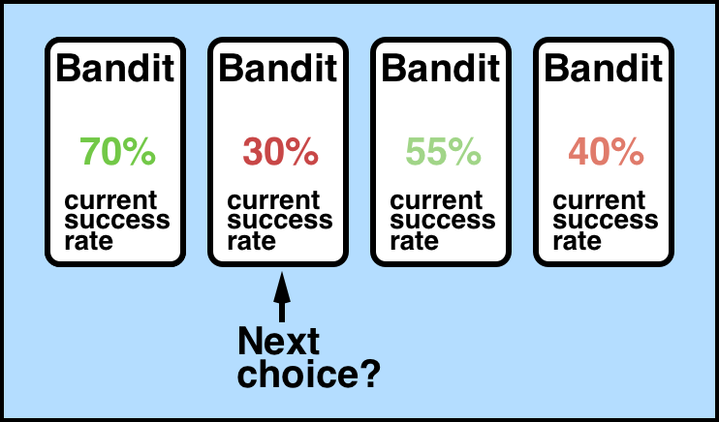
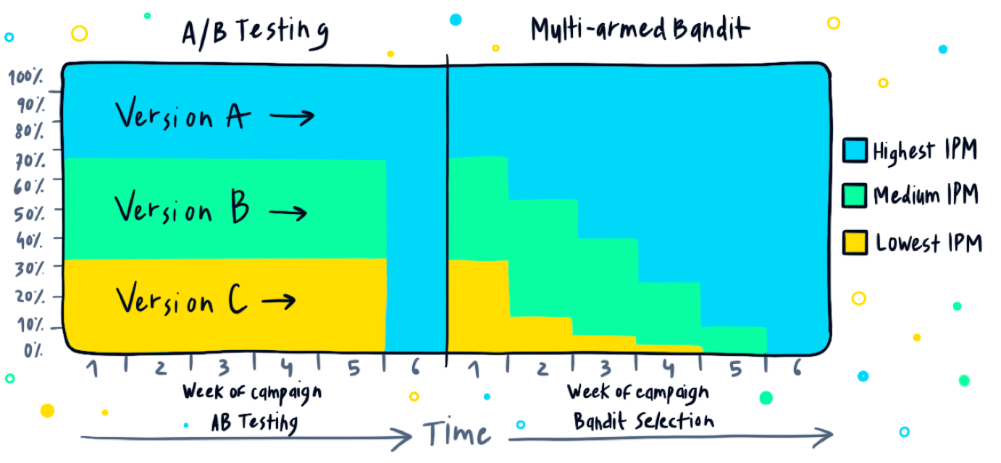
Multi-armed bandit – best where have web users and have high traffic
Idea that even though first bandit has highest success rate with converting customers, this may not be the case tomorrow, so explore another bandit to see if the case. May find that ofc to exploit current knowledge would have been best strategy
Carefully balances exploration vs exploitation – never rest on your laurels idea. Constant AB test on
Useful where high number of choices/actions
Also see https://www.kaggle.com/code/phamvanvung/basics-of-contextual-bandits
Competitor approach to AB testing
Issues with AB include
even if one version far outperforms the other from the get-go, traffic will still be allocated evenly -- with 50% of visitors seeing the underperforming version and the other half directed to the version that is pulling way ahead. Argue waste, if one version clearer better should reallocate to this
Bandit is essentially a policy / choice / action, such as a specific wording of text when card payment failed
Bandit algorithms are a class of algorithms primarily used for website optimisation
What piece of content to recommend
What product to recommend
What phrasing to use to ensure a customer updates their contact details
What
A smarter but more complex approach than AB testing. Finds currently best performing action
Think of a slot machine as a single armed bandit (you pull the arm and gamble your money)
Multi-armed suggests multiple different attempts
SHOULD produce faster results since there is no need to wait for a single winning variation
Example of Contextual MAB
Actions could be ways to max payment success rate
Contextual features could be card_type, n_successful_payments_last1yr, their banks avg payment success, card type etc.
Oracle = domain specific term for the classifier or function containing the clf that maps contexts and actions to the proba payment success. Could be a logistic regression/random forest etc.
Using historical data, the oracle learns to infer the probability of target. Issues with purely relying on this:
Underlying world might change from one moment to another (e.g. bank changes fraud system and suddenly block previously-successful payments)
If model poorly fitted probabilities are wrong
How easy would this scale?
Data Latency issues and how this might impact how quickly algorithm can update policy

Slide 8
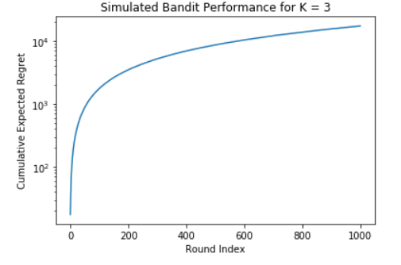
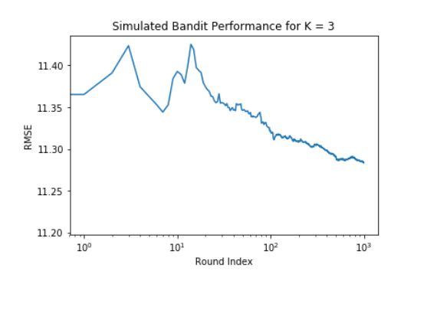
Performance measurement
Aim: try to maximise reward while reducing reward loss when exploring different bandits
We measure reward loss using ‘regret’
Regret = cumulative_reward_{optimal} - cumulative_{rewards}
The lower the regret, the better the model
If regret too high probably should reconsider your action-selection mechanism
Expect that regret gets smaller as able to exploit more data … will never be 0 in a round because world is not static + humans not perfectly predictable
For a single round, regret is what the optimal action reward would be minus the actual action reward (i.e. if use exploration action)
Presume that this trains a model and tries to predict test set for an increasing number of samples to show that with more examples RMSE decreases

Slide 9
CMAB
CMAB different to MAB in that it considers the context of the world too when making a decision
Contextual element factors in customer’s features, or context, when choosing a bandit. The context affects how a reward is associated with each bandit, so as contexts change, the model should learn to adapt its bandit choice E.G. User might be a designer so spends work hours looking to purchase wallpaper etc. but in free time loves knitting so spends evenings looking to buy yarn material etc. model should learn to adapt to know what to recommend to purchase at different times of day
Used for optimisation decisions
ML framework for personalisation + efficient information retrieval + anomaly detection
Learning algorithm should test the different actions and learn which one has most rewarding outcome given the context/state
Will find the best predictor of reward for each state
Goal of agent/learner (i.e. company making the decision to show which optimisation solution be it an ad etc) is to choose actions which maximise cumulative reward after T rounds (reward could be revenue stream or CTR)
At each round, t=1,2,3…T
X = the environment i.e. context
A = action chosen by agent (decision variable)
R = reward provided by the environment given the action (often y in a model)
Task
Produce an algorithm that optimally picks the actions that maximises the cumulative reward by using historical data
N.B. Normally have an explicit feedback loop to test the algorithm but do not here so take this into account
Use Case
Online retailer – when customer enters homepage only room to show 2 personalised products. If they buy, reward to company is price of item, if do not then reward = $0.
Use CMAB to maximise reward where each product is a bandit
See algorithms - Vowpal Wabbit library + UCB1
Cost of switching arms i.e. moving between actions
Finite lifespan of action (might not be able to use a certain tile on NFX as losing rights)
Extension to CMAB is reinforcement learning
Considers effect of sequence of decisions (i.e. allows decisions to affect the world)

Slide 10
Why use CMAB
maximizing cumulative rewards over time by learning an efficient explore vs. exploit policy
Exploit = choosing the bandit (i.e. policy) that maximises the current reward based on its historic success when applied in this context i.e. choose the winning strategy
Can simultaneously learn the effectiveness of different policies rather than wait for a single policy to be evaluated
Context may be very important to the policy chosen (i.e.
When model is certain about the best action, exploit this knowledge to max reward
If model is uncertain we should explore more
Could serve up N ads to customers over long enough period that learn the expected reward for each
Could then allocate ads that max reward
Issue with this is could take ages to learn expected reward, during which time you have incurred the cost of getting it wrong loads of times. Also, by the time you have an estimation, this data may not be as applicable to customers of the future.
Assumption that the distribution of rewards for a given action is not static through time (n.b. where the reward falls within this distribution is dependent on the context i.e. feature input space)
If it was stationary, would make sense to explore initially and then exploit all learnings for ever more, but that isn’t the real world
Need a strategy that can exploit knowledge learned now, but that can explore other actions so you can adapt to emerging trends of the future that carry larger rewards
Not a fully fledged reinforcement learning approach - a kind of hybrid between AB testing & Reinforcement Learning
RL too technically difficult to manage
A low latency ML framework to boost payment conversion rates

Slide 11
Exploitation vs exploration strategy – defining your action selection strategy
Balances exploitation & exploration
The extent of each depends on your action
Exploit
Exploits previous knowledge to maximise current reward i.e. greedy approach
E.G. Show camera enthusiast, camera-related products
Exploration
Explores other rewards because context / real world changes and past is not always good indicator of present
May therefore learn that previous best approach is no longer so and learn next best optimal decision
E.G. Show camera enthusiast, tech related products e.g. wearable tech
Good practice is to exploit more at the beginning, when agent’s information about the environment is less accurate, and gradually adapt this policy as more knowledge is gained
Strategies
Explore-first
Pre-define n examples you wish to explore (i.e. first 1000 customers you just randomly uniformly allocate to one of A actions)
Then use the learnings from these n examples to predict the best action for all subsequent instances
Epsilon greedy
good default
Greedy approach involves just choosing the winning strategy 1-epsilon of the times
1-epsilon – where you define epsilon e.g. 0.1
meaning the prediction of the current learned policy is taken with 90% and with the remaining 10% , an action is chosen uniformly at random
Bagging (bootstrap aggregating) explorer
Define number of bootstrap samples (/intervals/folds) e.g. 5
Assign each example to one of the 5 folds
Train a model on each fold and uniformly picks an action from each fold uniformly at random
This will rule out obviously bad actions, while exploring amongst the plausibly good ones when the variation amongst the m policies is adequate.
Online Cover
Supposedly most sophisticated for CMBA
Like bagggin explorer, except the training of each bootstrap sample is optimised to give a diverse set of predictions, choosing all of the actions that are not already learned to be bad in a given context
I believe other ones include UCB1, Bayesian UCB, and EXP3

Slide 12
AA Testing
Basically, a preliminary way to check that the mechanisms of your new AB testing tool work before you actually spend/risk money on it
Will show two exactly identical pages
Aim is not to discover a lift in conversions, BUT to ensure there is no difference between control and variation versions
When to use
when organizations are implementing a new A/B testing tool
Checking the accuracy of the A/B testing tool being implemented
Setting a baseline conversion rate for future A/B tests
Deciding on a minimum sample size
Organizations who are about to purchase an A/B testing tool or want to switch to a new testing software may run an A/A test to ensure that the new software works fine and has been set up correctly
a good way to run a sanity check before you run an A/B test
check if there is any discrepancy in data, let’s say, between the number of visitors you see in your testing tool and the web analytics tool
in cases where an A/A test provides a winner between two identical variations, there is a problem. The reasons could be any of the following:
The tool has not been set up correctly.
The test hasn’t been conducted correctly.
The testing tool is inefficient.

Slide 13
AA Test - Step By Step (Jupyter Notebook in Google Colab)
Installs & imports packages
Connect to Snowflake (sqlalchemy, snowflake.sqlalchemy)
Defines functions
Return T-test p-value
Final function print_metrics(metric_stats, bucket1=‘treatment’,bucket2=‘control’)
Extracts results from having run the AA test which are stored in Snowflake
Think needs to unhash data using hash function & hash salt
metric_stats is basically a table returned from inline SQL
%%sql metric_stats <<
WITH metrics AS ( ….. Full SQL script that returns table like below, with params )
WHERE dt {{date_range}}
For each metric: considers the mean, variance, and sample size of the treatment, control and other groups
Metric | Treatment Mean | Control Mean | Other Mean | Treatment Variance | Control Variance | Other Vartiance | Treatment Sample Size | Control Sample Size | Other Sample Size
Conversions | 0.6 | 0.61 | 0.58 | 0.1 | 0.1 | 0.09 | 2000 | 2010 | 1995
Clicks
Time on page

Slide 14
!pip install “sample-size>=3.0.0”
From sample_size.sample_size_calculator import SampleSizeCalculator
SampleSizeCalculator(Alpha=0.5, Power=0.8)

